Slide 1
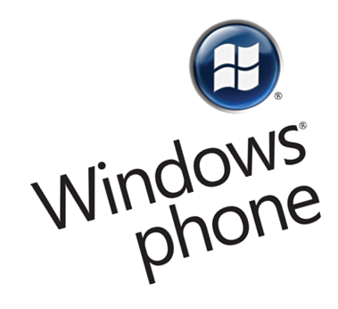

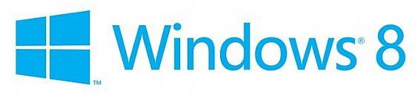

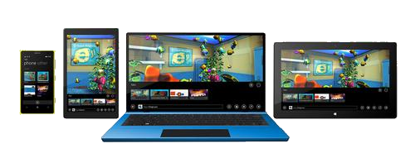
Windows Universal App
Writing an App

Slide 2
Simple Windows Universal App
Live Demo

Slide 3
XAML Overview
http://academy.telerik.com

